Slide 1

TEAM
QUAD CLAN

Slide 2
TABLE OF CONTENTS
01
Our Team
02
04
Problem Description
Approach
03
Why RPA ?

Slide 3
THE TEAM
MUHAMMAD TABISH KHANDAY
MURTAZA ASHRAF SHAH
MOHAMMAD AFRIDI BHAT
TAMANA KOUL

Slide 4


ABOUT THE PROJECT
COURSE INVENTORY
AUTOMATION

Slide 5

PROBLEM DESCRIPTION

Slide 6
Why RPA for this Project ?
REDUCES EFFORT
SAVES TIME
EASY ACCESS
REDUCES
COMPLEXITY

Slide 7

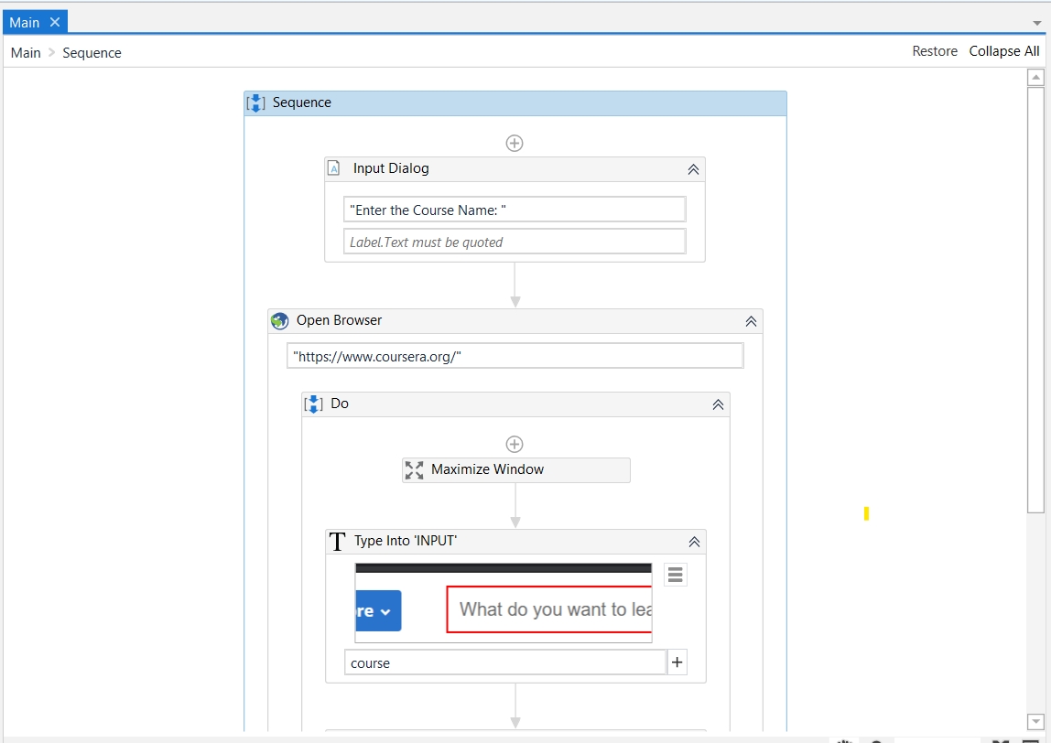








APPROACH TO SOLVE THE PROBLEM STATEMENT

Slide 8
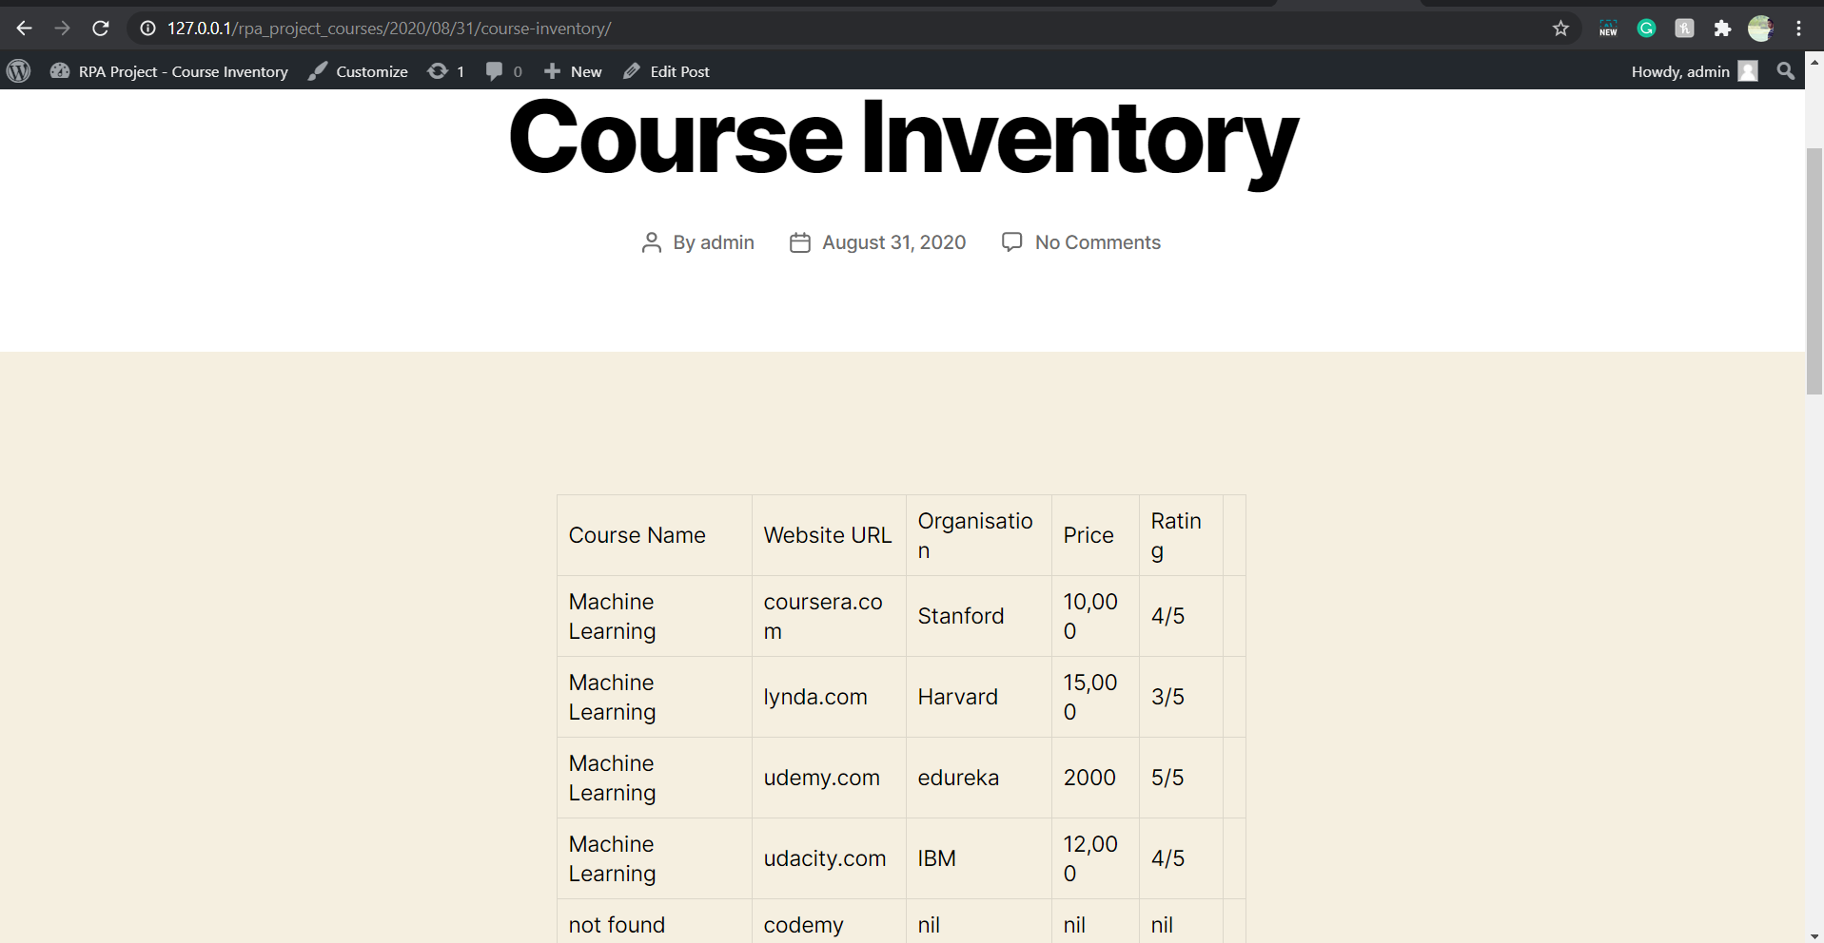
Final Output

Slide 9
THANKS!
RPA

